Slide 1

WEB MEDICAL MANAGEMENT SYSTEM
Team ID: PT2-394
Name: Ms. Puchha Bhavya (42614102)
Ms. J . Prerna (42614101)
Dept: CSE in specialisation with Cyber Security
Project Supervisor
Dr. Mary Posonia,M.E.,Ph.D.,
Head of the department
Department of CSE

Slide 2
Presentation Outline
Introduction
Objectives
System Architecture / Ideation Map
Module Implementation
Application Snapshots
Results and Discussions
Conclusion & Future work
References
Course Certificate

Slide 3
Introduction
The Web Medical Management System is a console-based platform to streamline the daily operations of hospitals and clinics. It offers a centralized platform to manage patient details, doctor schedules, medical histories, billing, and inventory with ease. The system supports multiple user roles, including admin, doctor, receptionist, and patient, each with role-specific functionalities.
This system provides an all-in-one platform for doctors, patients, and administrative staff to interact, manage, and retrieve medical information efficiently. Its primary goal is to offer a scalable and secure environment to handle various medical and administrative processes with ease.
By digitizing medical records and automating tasks like appointment booking, billing, and reporting, the system reduces paperwork, minimizes errors, and saves time for both staff and patients.
It is accessible via any device with an internet connection, ensuring flexibility and real-time access to data. This project aims to improve the overall efficiency, accuracy, and reliability of healthcare management.

Slide 4
Objectives
1.Streamline Patient Management
Enable efficient registration, appointment scheduling, and record maintenance for patients.
2. Improve Doctor-Patient Interaction
Provide a portal for doctors to access patient records, prescribe medications, and track treatment history.
3.Digitize Medical Records
Store and manage patient data securely to eliminate paper-based records and support quick access to medical history.
4.Facilitate Online Appointments
Allow patients to book, reschedule, or cancel appointments through a user-friendly online interface.
5.Manage Billing and Invoicing
Automate billing processes, generate invoices, and track payments for medical services.

Slide 5
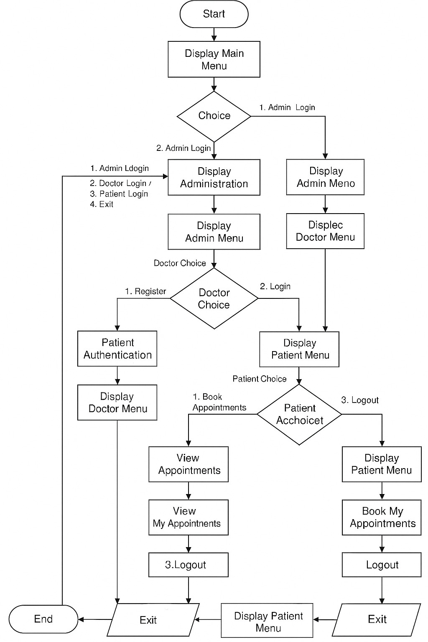
System Architecture / Ideation Map

Slide 6
Module Implementation
1. Requirement Analysis
Goals:
Understand the needs of patients, doctors, and admins.
Define the system’s scope (features, modules).
Deliverables:
Use-case Diagrams: Show interactions between users and the system.
Functional Requirements: Detailing the features each module should have.
Non-functional Requirements: Performance, security, and scalability needs.
2. System Design
3-tier architecture:
Backend: Server-side logic (Node.js).
Database: Storage solution (MySQL, PostgreSQL, MongoDB).
.

Slide 7
Module Implementation
3. Module Development
a. Authentication Module:
User registration/login.
Role-based redirects for different users (admin, doctor, patient).
b. User Dashboard:
Separate dashboards for admin, doctor, and patient.
c. Doctor Management:
Admin can add/edit/remove doctor profiles.
Assign specializations and set schedules.
d. Patient Management:
Doctors and admins can view/update patient information.
Upload and view medical history and files.
e. Appointment Booking:
Show available schedules for doctors.
Book, reschedule, or cancel appointments.

Slide 8
Module Implementation
f. Medical Records:
Doctors can add/edit diagnosis and prescriptions.
Patients can view/download medical records.
g. Billing & Payments:
Automatic invoice generation.
Integration with payment gateways like Razorpay, Stripe, or PayPal.
h. Inventory/Pharmacy:
Add/manage medicines in inventory.
Alert when stock is low or needs replenishment.
i. Notifications:
Email/SMS reminders for appointments and prescribed medications.
j. Reports & Analytics:
Generate reports: user activity, revenue, patient visits, etc.
Provide charts and graphs for insights.

Slide 9
Module Implementation
4. Testing
Types of Testing:
Unit Testing: Testing individual components/modules (e.g., authentication, booking).
Integration Testing: Testing the interaction between modules (e.g., medical records and billing).
User Acceptance Testing (UAT): Testing by real users (patients, doctors) to ensure the system meets their expectations.
Tools: Jest, Mocha (for unit testing), Postman (for API testing).
5. Documentation
Includes:
Project Report: Objectives, system architecture, features, and testing outcomes.
Installation Guide: Step-by-step instructions for setting up the system locally or on a cloud server.

Slide 10
Module Implementation
6. Presentation / Demo
Deliverables:
Video Walkthrough: A short video demonstrating key features of the system.
Slides: Presentation slides outlining the system’s architecture, features, and benefits.
Live Demo: If the application is deployed, provide access for stakeholders to interact with the system.

Slide 11
Design Requirements
Hardware Requirements:
Processor: Minimum 1.8 GHz Dual-Core (Intel or AMD)
RAM: At least 4 GB (8 GB recommended for smooth performance)
Storage:
- Minimum 500 MB for source files and basic storage
- Additional space if external database or patient reports are stored
Display:
1024x768 resolution or higher
Input Devices: Standard keyboard and mouse
Operating System: Compatible with Windows, Linux, or macOS

Slide 12
Design Requirements
Software Requirements:
Programming Language: Java (JDK 8 or higher)
IDE: Eclipse / IntelliJ IDEA / NetBeans (any Java-supported IDE)
Compiler: Java Compiler (java)
Database (Optional for advanced version):
- MySQL or SQLite for persistent storage
- OR text/CSV file-based storage for basic version
Version Control (optional): Git (for collaborative development)
Documentation: Microsoft Word / Google Docs for report creation
Operating System Compatibility: Cross-platform (Windows, Linux, macOS)

Slide 13
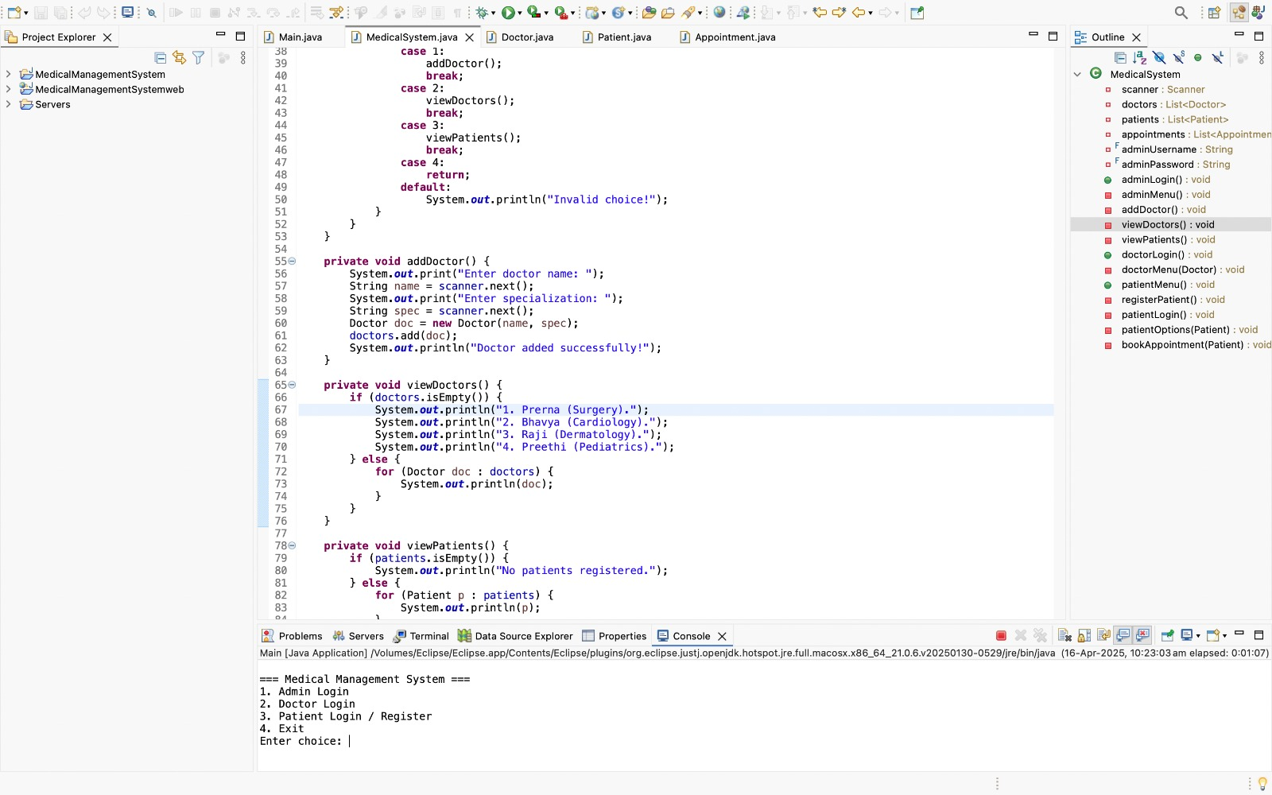
Application Snapshots

Slide 14
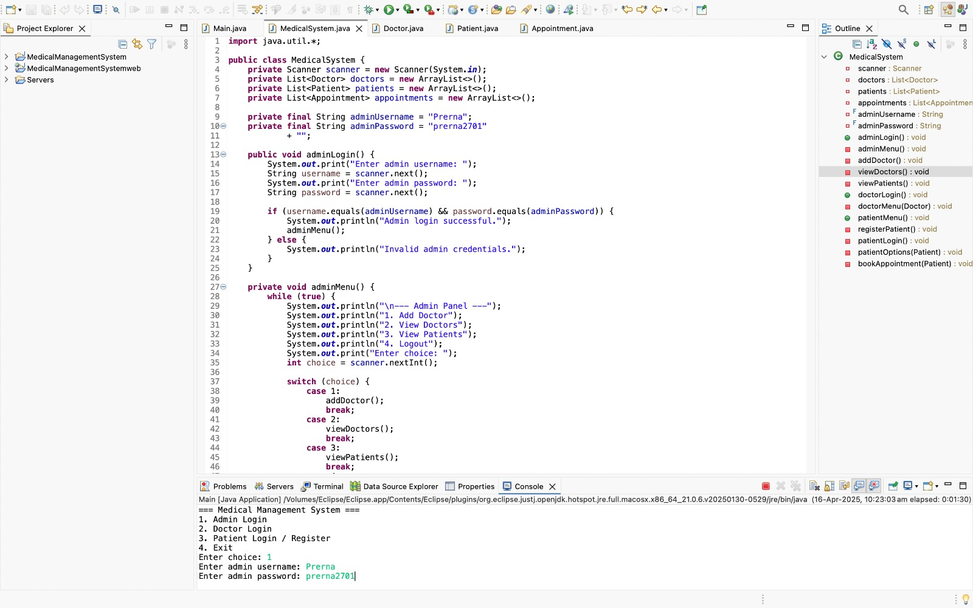
Application Snapshots

Slide 15

Application Snapshots

Slide 16
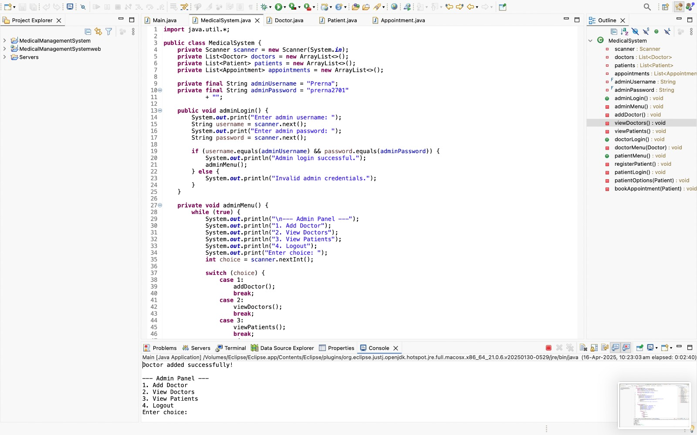
Application Snapshots

Slide 17
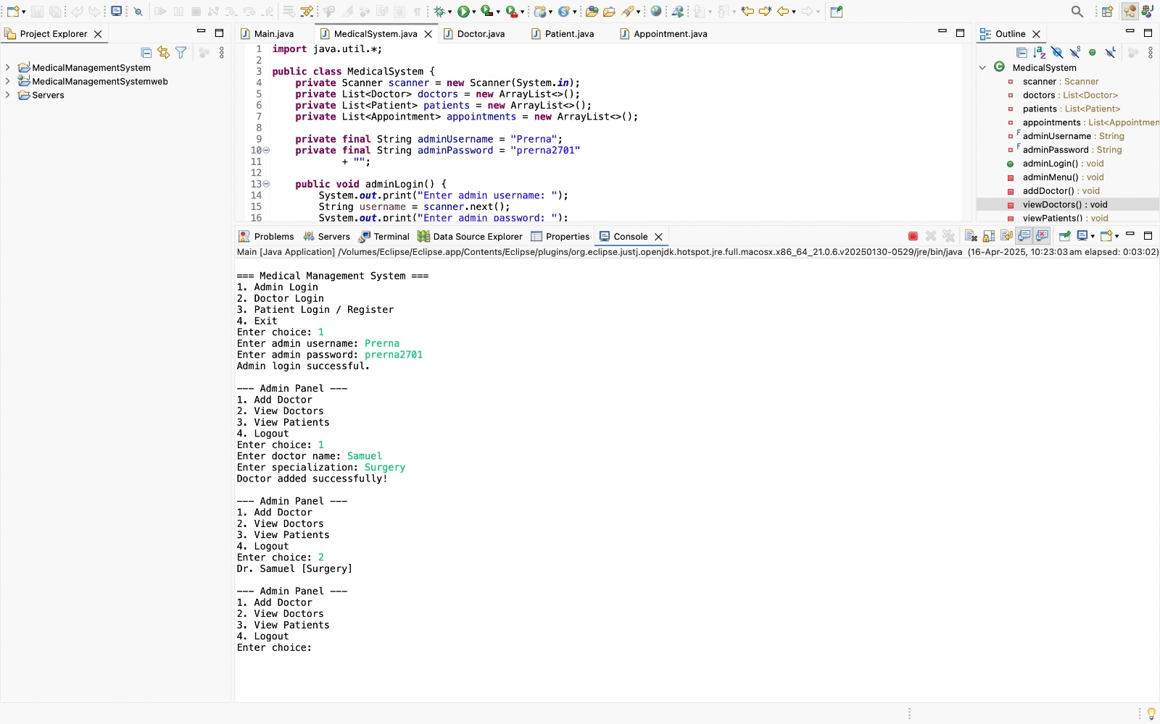
Application Snapshots

Slide 18

Application Snapshots

Slide 19
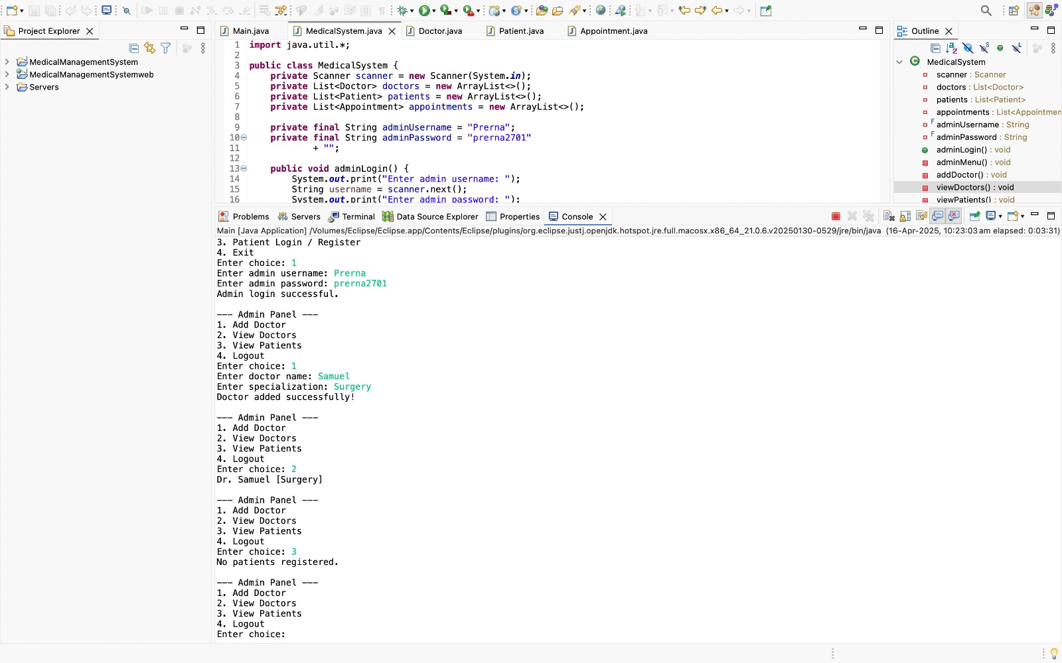
Application Snapshots

Slide 20
Application Snapshots

Slide 21
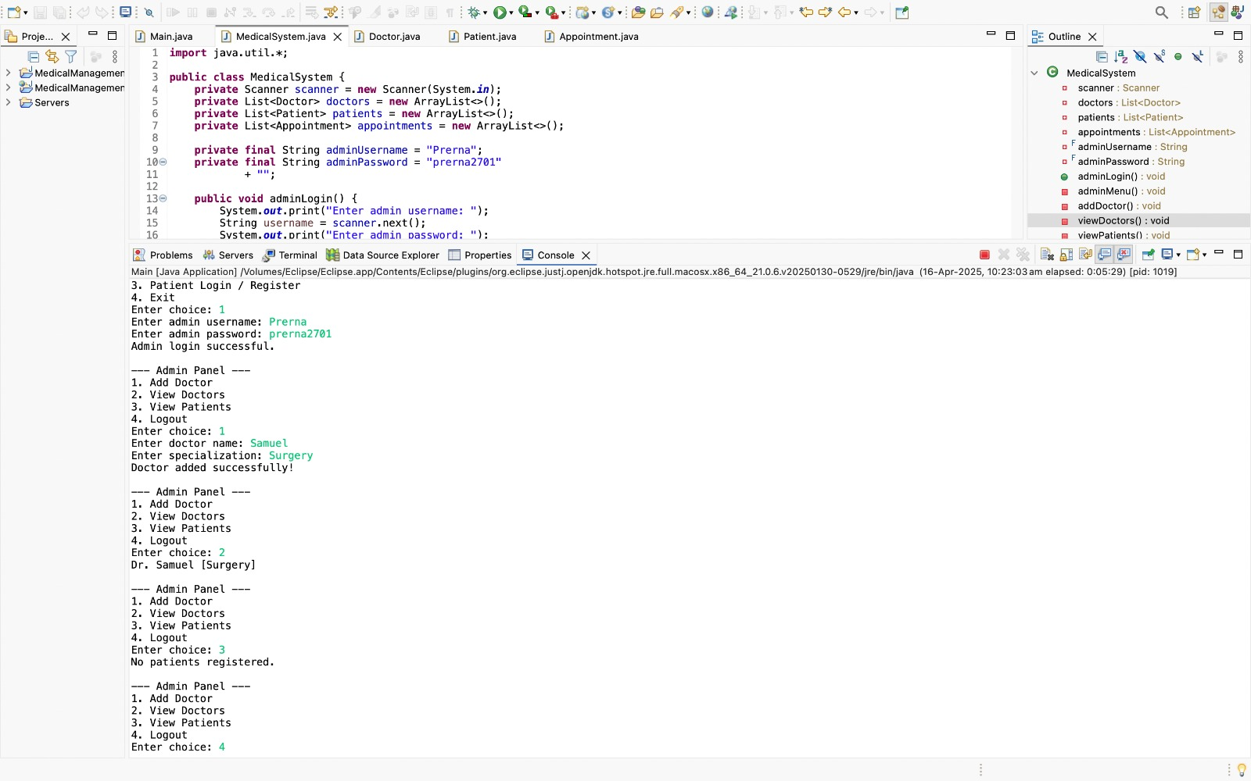
Application Snapshots

Slide 22
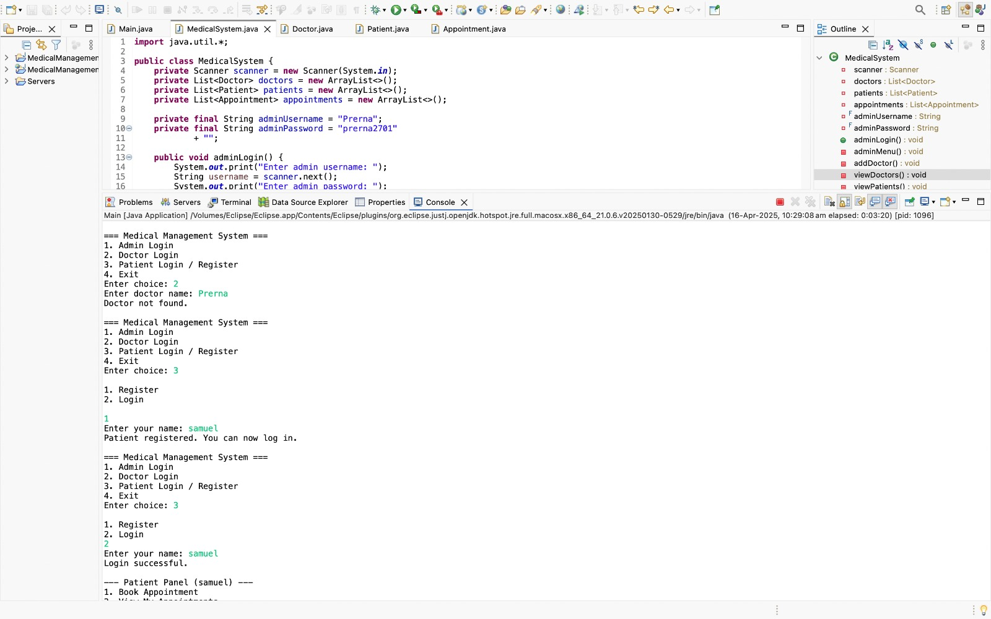
Application Snapshots

Slide 23
Methodology
1.System Design – Designed using Java classes for patients, doctors and hospital systems
2.User Interface- console based menu to allow easy navigation for users, used arraylists to store data of patients and doctors.
3.Login System – developed for both doctors and patients with usernames and passwords.
4.Testing – Conducted unit, integration, and user acceptance testing.
5.Requirement Gathering – Collected functional needs from doctors, patients, and staff.

Slide 24
Results and Discussion
The Web-Based Medical Management System was successfully developed to streamline healthcare operations through features such as role-based access for administrators, doctors, receptionists, and patients; appointment scheduling; patient records management; billing and inventory tracking; and real-time analytics. Testing showed increased operational efficiency, reduced manual errors, and positive user feedback due to the intuitive interface and secure data handling. The system enhanced access to medical information, improved coordination among staff, and supported decision-making through integrated reports. While performance depends on internet connectivity and there is a slight learning curve for new users, the system proved scalable and adaptable, with potential for future enhancements like mobile integration and AI-assisted diagnostics.

Slide 25
Conclusion
The Web Medical Management System successfully streamlines the management of healthcare data and services by providing a centralized, user-friendly platform for patients, doctors, and administrators. Through this system, routine tasks such as appointment scheduling, patient record management, and prescription tracking are efficiently handled, reducing manual errors and saving time. The implementation of this web-based solution enhances accessibility, ensures data accuracy, and promotes better communication between medical personnel and patients. Overall, the project demonstrates how digital tools can significantly improve the effectiveness and efficiency of healthcare delivery. Future enhancements could include integration with wearable health devices, real-time analytics, and mobile app support to further extend the system's capabilities.

Slide 26
References
1. Tanenbaum, A. S., & Wetherall, D. J. (2011). Computer Networks (5th ed.). Pearson Education. → Provides insights on client-server architecture and data exchange, relevant to the medical system's backend.
2. Pressman, R. S. (2014). Software Engineering: A Practitioner’s Approach (8th ed.). McGraw-Hill. → Offers methodologies for software development life cycle used in this project.
3. Kumar, V., & Sharma, S. (2017). Modern Medical Information Systems: Design and Development. Tata McGraw-Hill. → Details common design strategies in hospital management software.
4. Chaudhary, S., & Singh, R. (2020). “Design and Implementation of Hospital Management System: A Case Study.” International Journal of Computer Science and Mobile Computing, Vol. 9, Issue 3. → A peer-reviewed paper discussing real-world hospital system implementations.
5. WHO Health Systems Toolkit, World Health Organization (2015). → Provides structural requirements for managing healthcare delivery systems.

Slide 27

Course Certificate

Slide 28

Course Certificate

